Slide 1




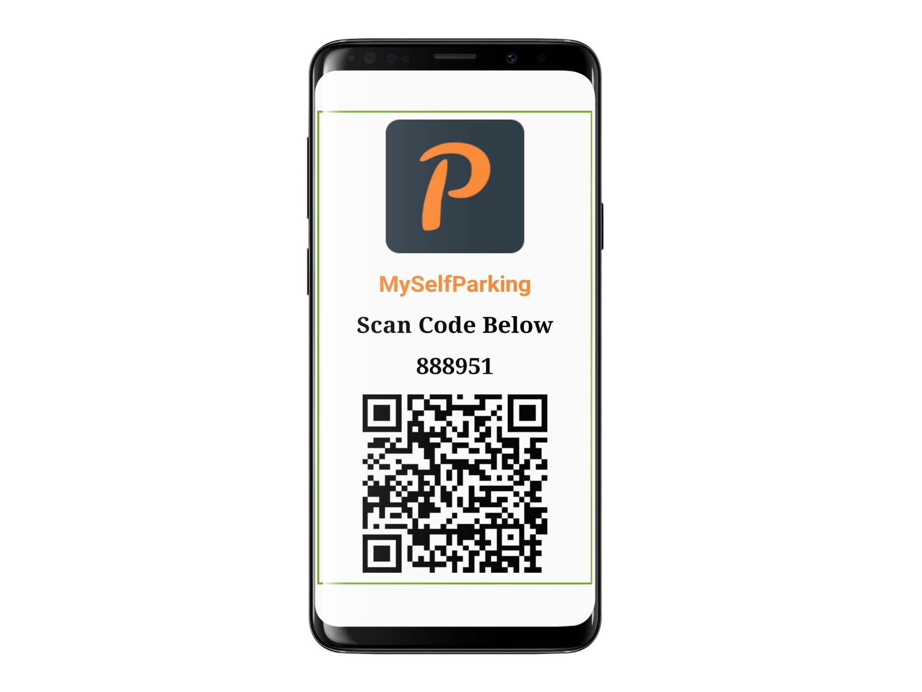

Modern Visitor Management
Register
Permit
Check-In
Notify
Modern Visitor Management
Modernize your visitor management with MySelfParking. Effortlessly permit and control access to your property with precise controls and detailed reporting.
Your tenants will love the ease of scheduling and managing their personal guests, while your employees will benefit from reduced manual and error-prone visitor check-ins. Visitors to your property will appreciate quick and smooth Check-Ins.
Visitor details are pre-registered
Visitor is permitted access according to defined rules
Visitor is manually or automatically Checked-In
Your tenant is notified via SMS or Email of the Visitors arrival
www.myselfparking.com

