Slide 1

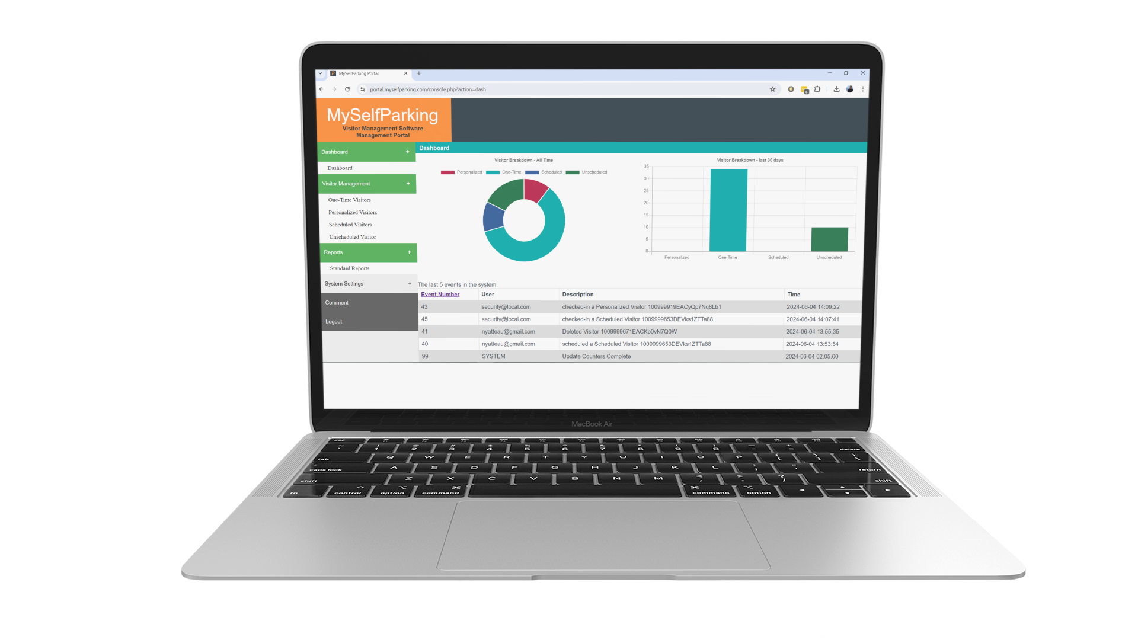








MySelfParking
Methods of Access
Automated check-in
QR code scanned at entry device
Manned check-in
QR code scanned by staff
Mobile App Trigger
Mobile App opens gate
Summer 2025
Single Solution
3 Methods of Access
  Integration to Parking Gate
  Manned booth
  Mobile App Trigger
Features
Auto Check-In on Pass Issuance
Entry and Exit Pass configurations
Single pane of glass dashboard
Register
Permit
Check-In
Notify
www.myselfparking.com

